Slide 1
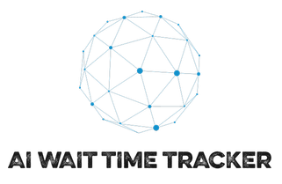
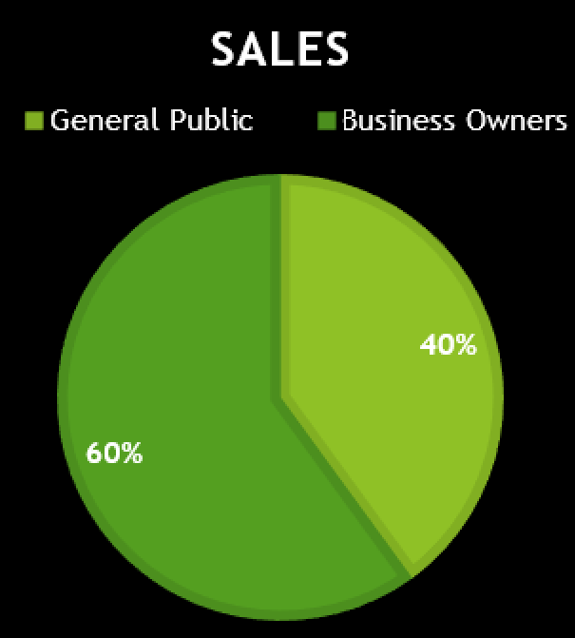
AI Business Wait Time Tracker
Target Market:
Business owners (like Hotels, Restaurants, Grocery Stores, Malls, etc.)
and general public.
Value Propositions:
Dashboard features, Reducing the manual work, Enhanced safety and improve
Customer experience.
Ramya Sri Yalanati
Vamsi Krishna Battula
Hima Sekhar Devarinti
Nikhil Chavan
Dixit Bharatkumar Patel

Slide 2

Challenges
Impact on business
Lack of AI web applications ​
Manual work requirement
No customers' safety

Slide 3
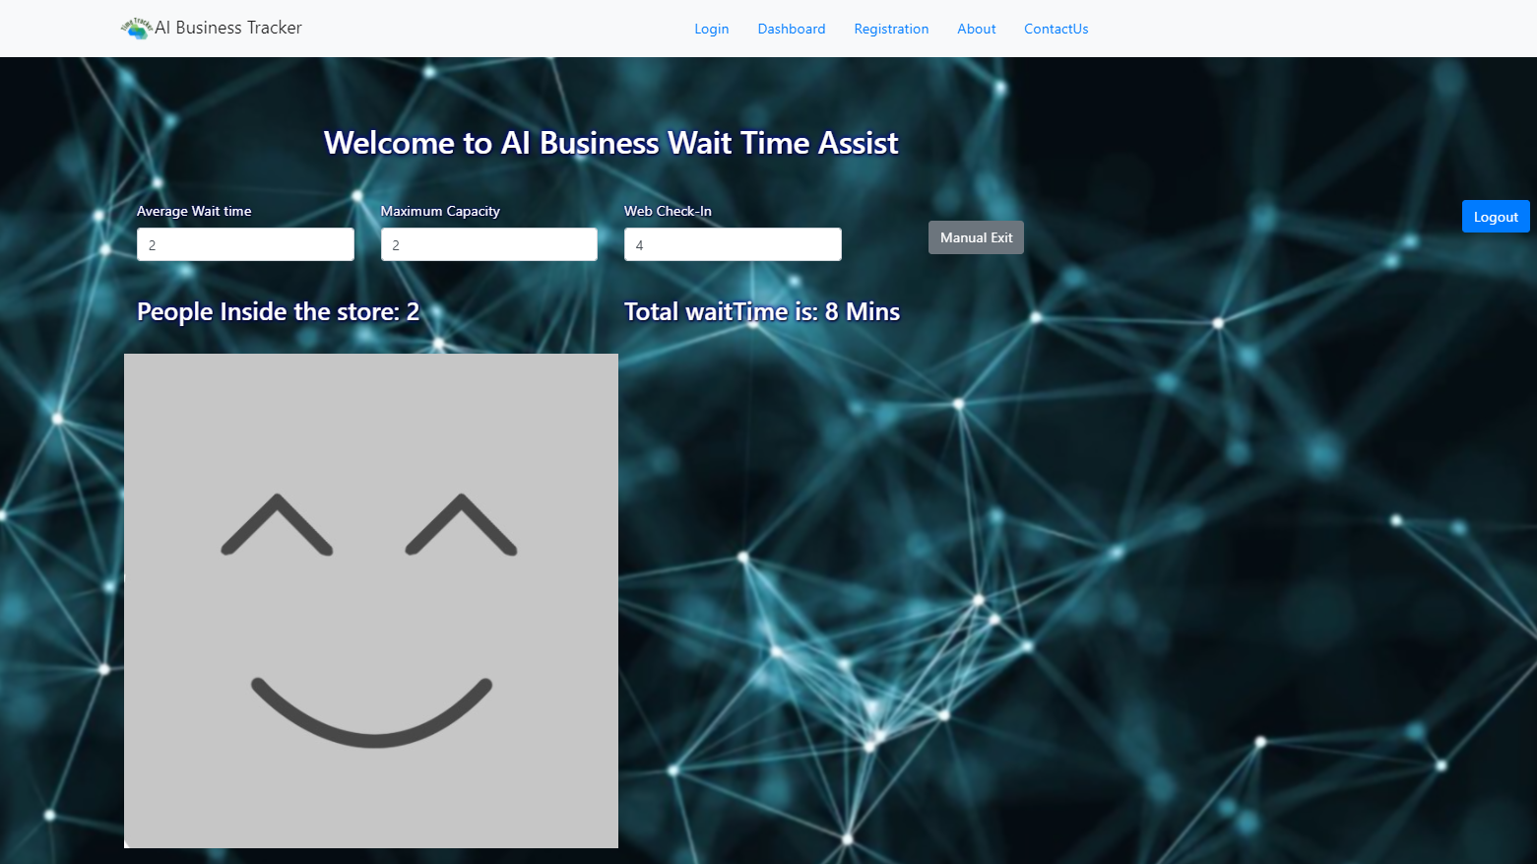
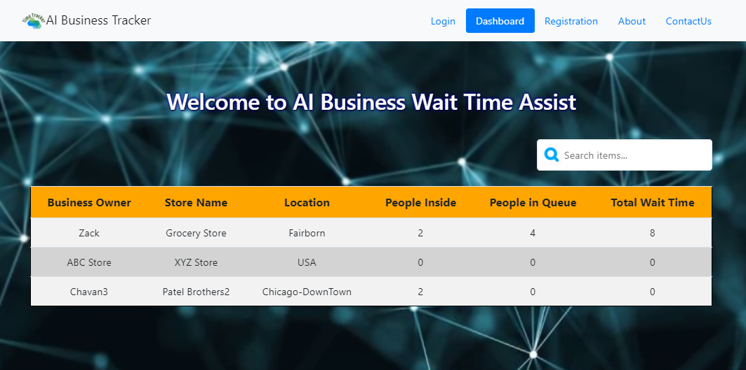
AI Based Web Solution
Wait Time Tracker
Live video processing
Web based application
Customers safety & satisfaction
Increase in sales
Fig: AI Business Wait Time Tracker Business Page
Fig: AI Business Wait Time Tracker Dashboard

Slide 4
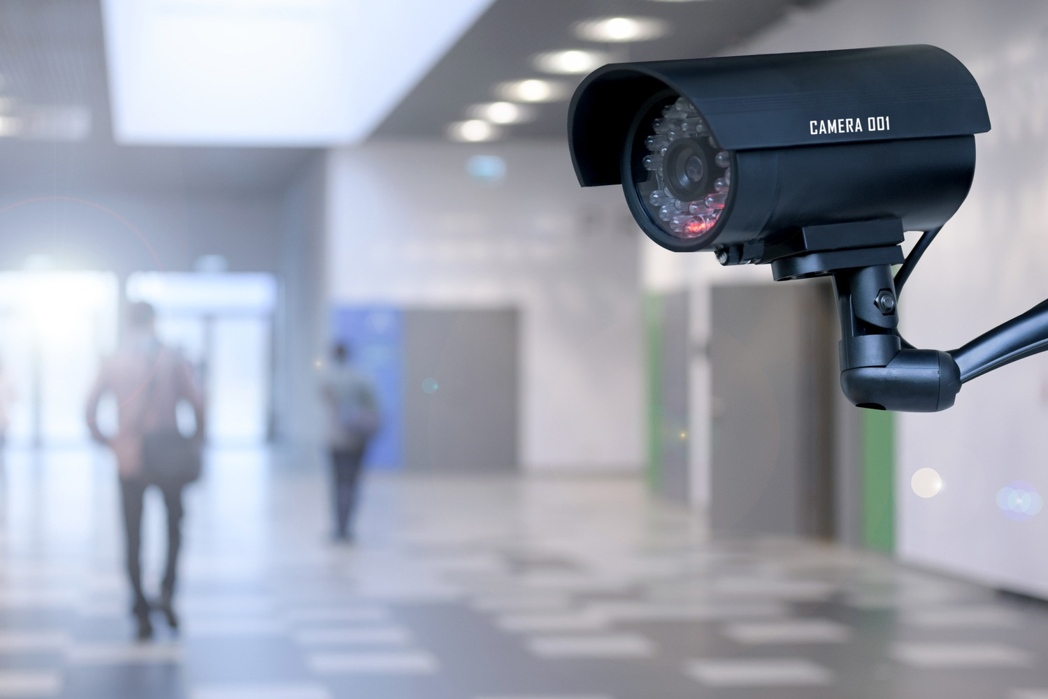
Key Features & Justifications
1. AI Live Video Processing
Tracking humans over non-human objects
TensorFlow.js Person detection (Open Source)
Responsive client-side singe page application
Real Time Data with no GPU hassle
Eliminates additional infrastructure cost

Slide 5
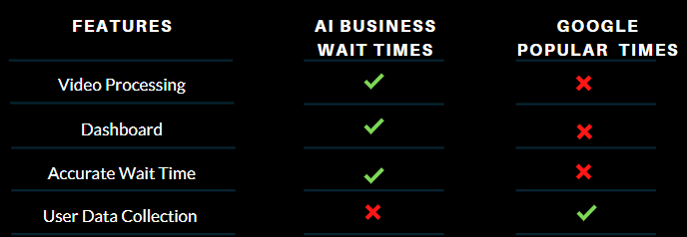
Continued...
2. Dashboard
Search and Web Check-In for businesses
Accurate wait times with real time data
Open-source auto scaling Google Firebase database
One stop user friendly Dashboard
Table: AI Business Wait Time Tracker vs Google

Slide 6

3. Data Privacy
Continued...
No user data collection
Complying with data privacy regulations
Reduced cost of development
Secure and no chance of data breach and explosion

Slide 7
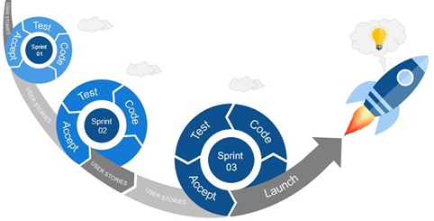
AI Business Wait Time Tracker
Business Module
General Module
Dashboard : Store Name , Location, No of people inside, Total wait time
Prototype Functionality & App Workflow
Yes
No
Textbox for AVG Wait time per person, Capacity, No of people waiting outside, No of people inside, Avg wait time calculation.
Phase1
Business owners have access to web application, where they could track the number of people shopping. Thus, improving the efficiency or the workloads of the employees.
Selling our AI web application to business owners would make profits.
Phase 2
Web analysis and automatic wait time generator by the historical data generated on our database.
Phase3
Dashboard Advertising on the dashboard to generate profits for the business owners.
improvements by providing review system and ratings.
Registration Page

Slide 8
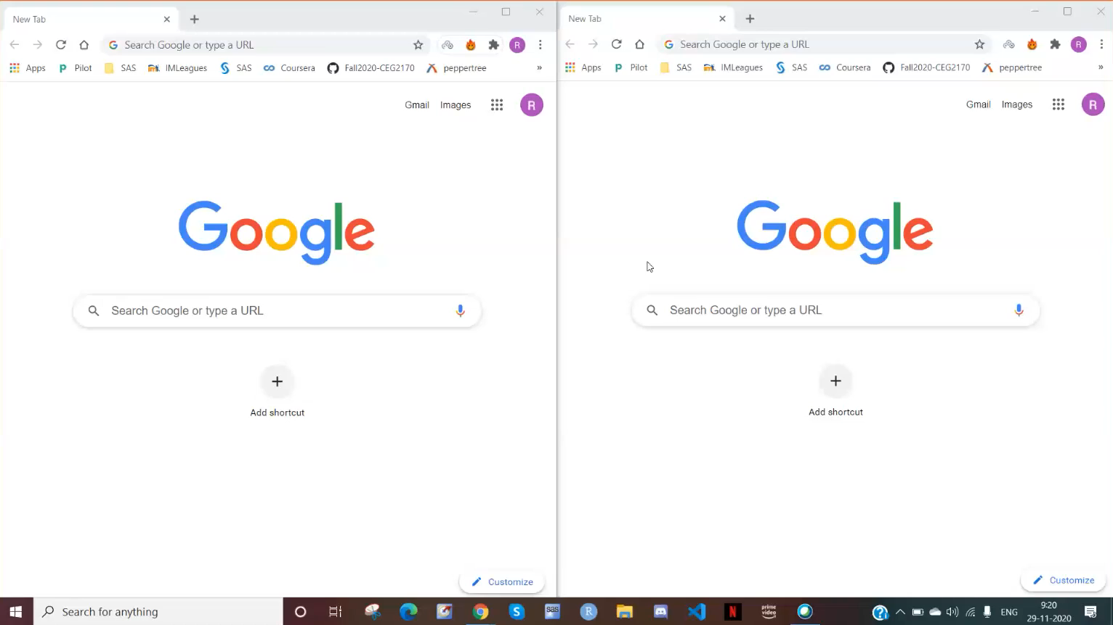
Demo Video

Slide 9
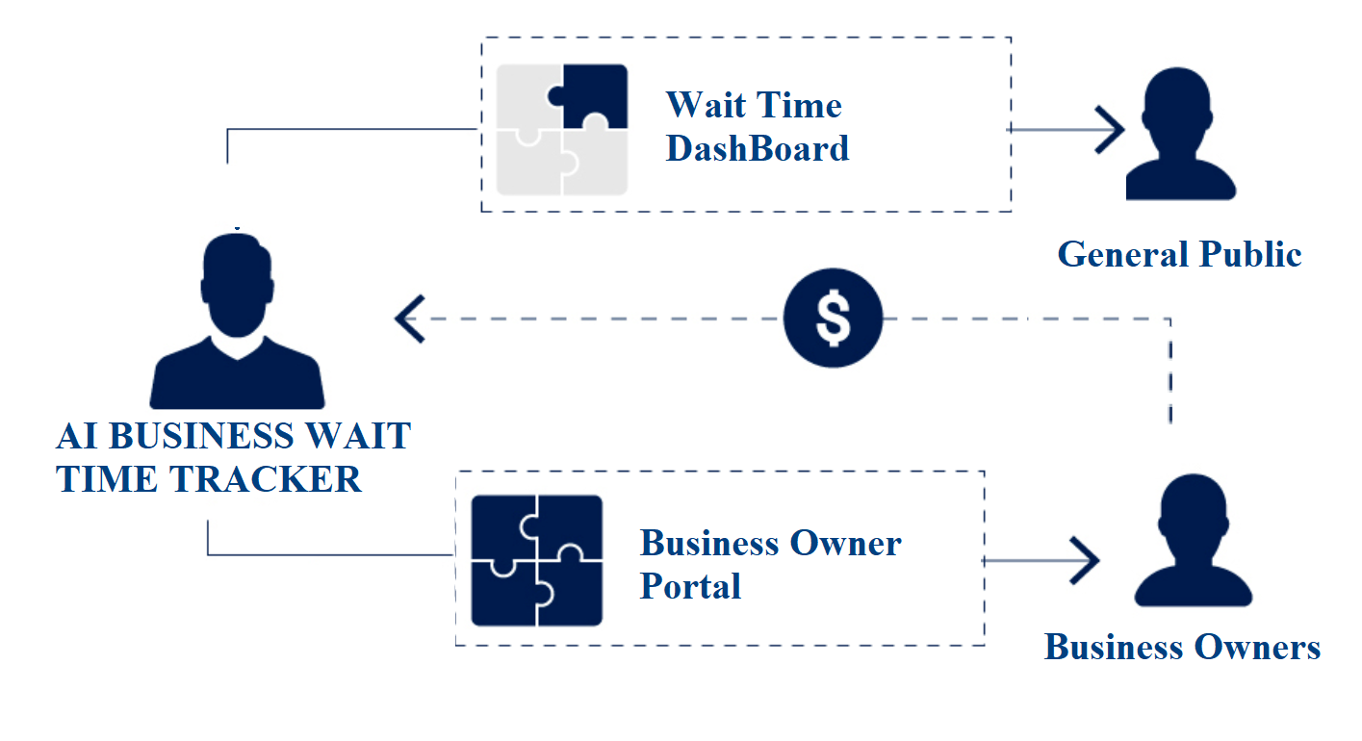
Business Model
Business owners have access to web application, where they could track the number of people shopping. Thus, improving the efficiency or the workloads of the employees.
Selling our AI web application to business owners would make profits.
Advertising on the dashboard to increase customer base and generate profits for the businesses.

Slide 10
Team Members & Contributions
Ramya Sri Yalanati
Vamsi Krishna Battula
Hima Sekhar Devarinti
Nikhil Chavan
Dixit Bharatkumar Patel
Team Member | Contribution
Ramya Sri Yalanati | Firebase DB Setup and Deployment
Vamsi Krishna Battula | Project Setup, Marketing and Management
Hima Sekhar Devarinti | Testing and Validation
Nikhil Chavan | Business Logic Implementation
Dixit Bharatkumar Patel | UI Implementation, Github Setup and Search Functionality

Slide 11
Final Release Prerequisites
Implementation Plan
Technical Validation
Market Entry
Scale up
Implementation plan basically involves the software development lifecycle model.
Technical Validation: AI Video processing, Live Database updates, Request Handling, Edge case scenario, Dashboard functionality and Low-cost maintenance.
Market entry: Live demo, Benefits and offers for the business, Existing customer Re-Marketing and Digital Marketing to expand the business.
Scale up: Database deploy in different regions, Vertical and Horizontal Scaling, Maintaining Cache Database like Redis.

Slide 12
Thank you... Any Question?
Contact Info
Email to: aibusinesswaittimetracker@gmail.com

